Slide 1
6. Sınıf 1. Ünite LIFE
Edited by www.okanelt.com

Slide 2
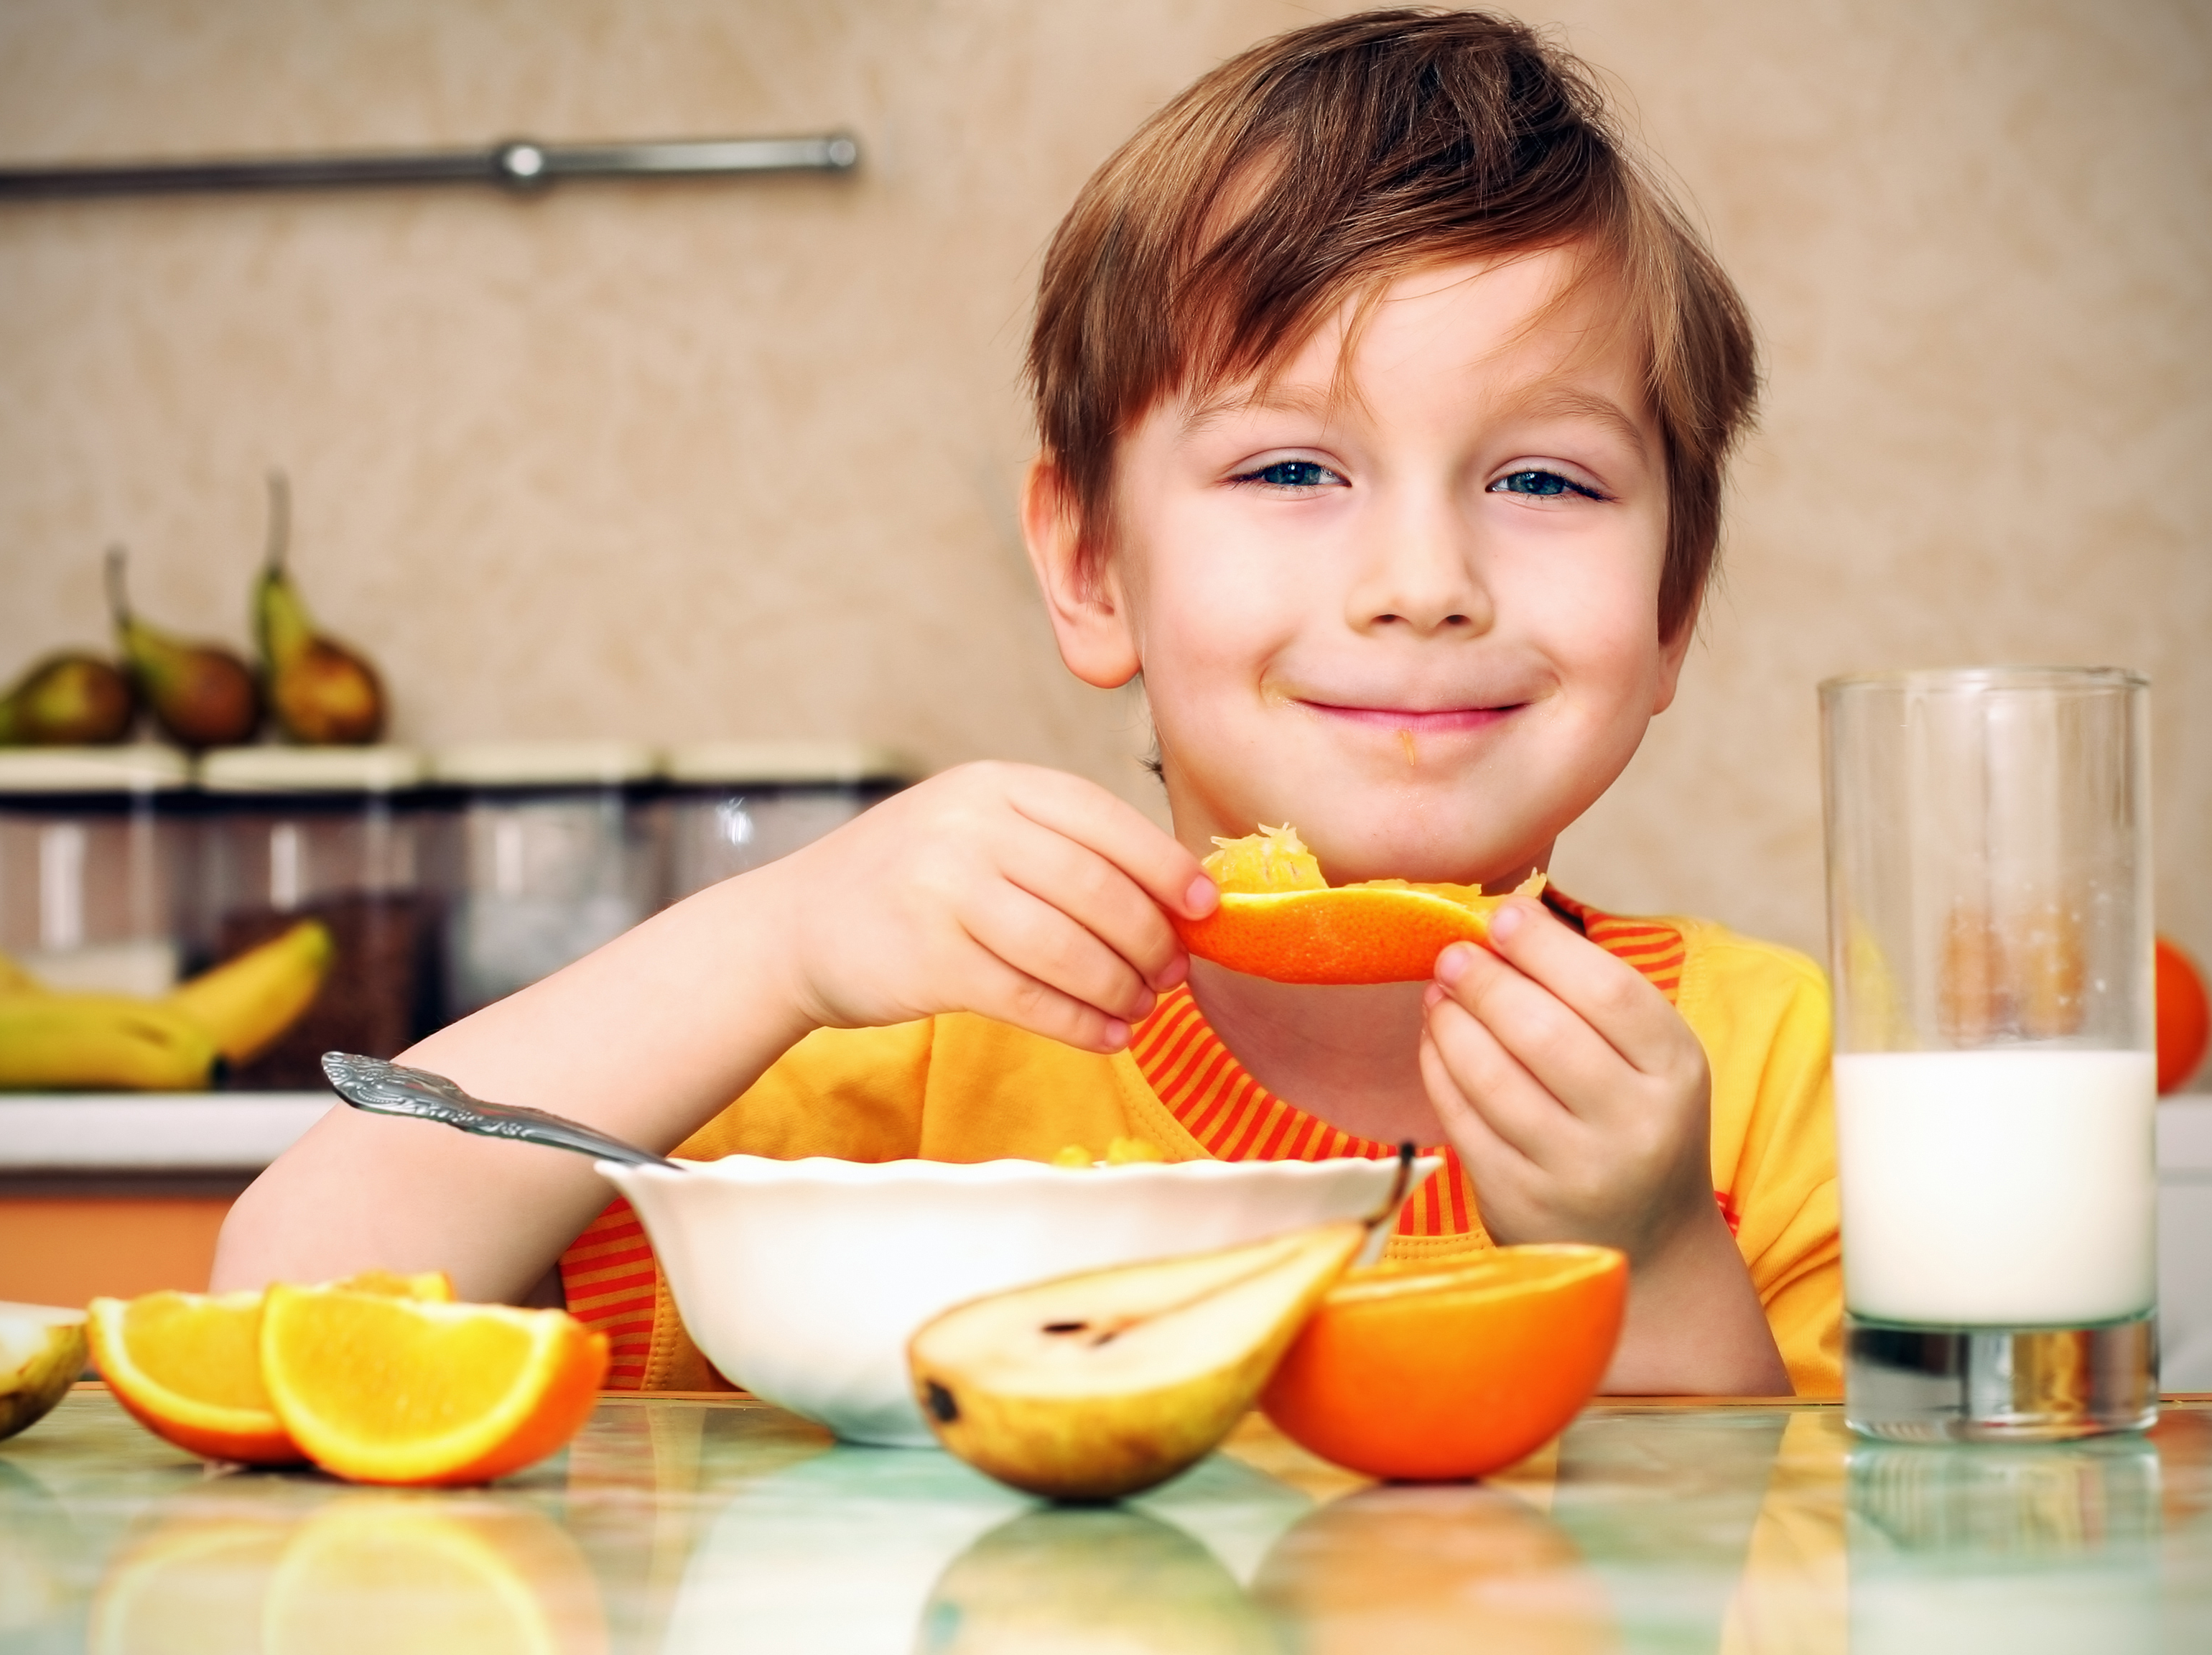

He eats his breakfast at 8:00.
What time do you eat your breakfast?

Slide 3
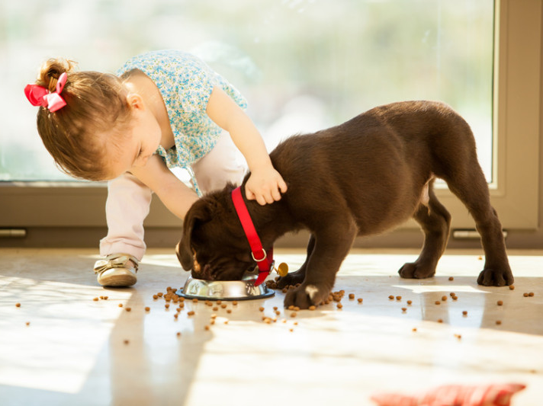
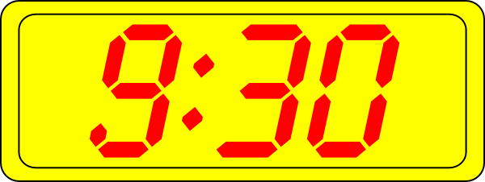
She feeds her pet at 9:30.
Do you have a pet?

Slide 4
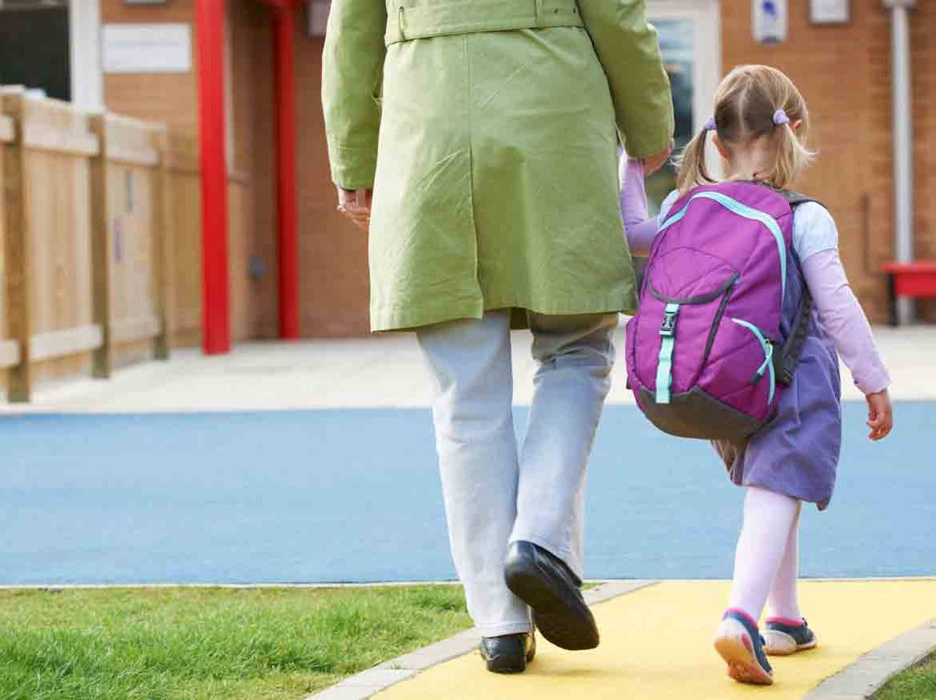

She goes to school at 7:15.
What time do you go to school?

Slide 5
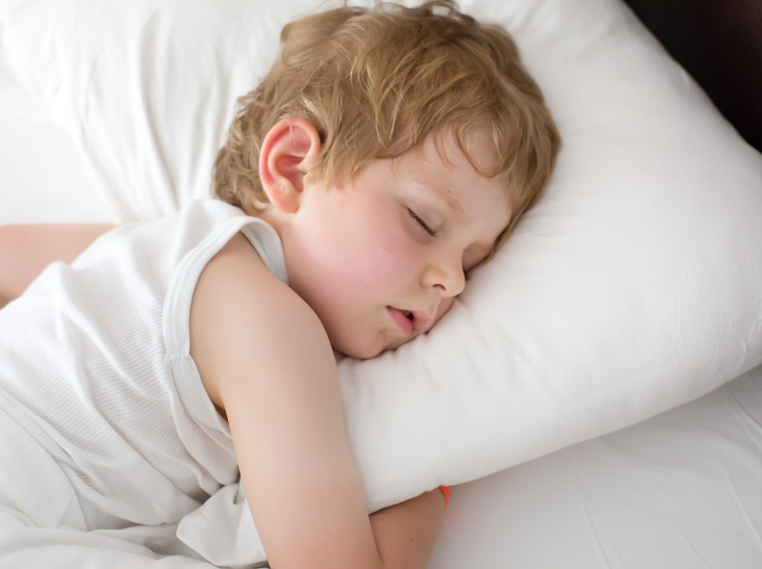

He goes to bed at 9:00.
What time do you go to bed?

Slide 6
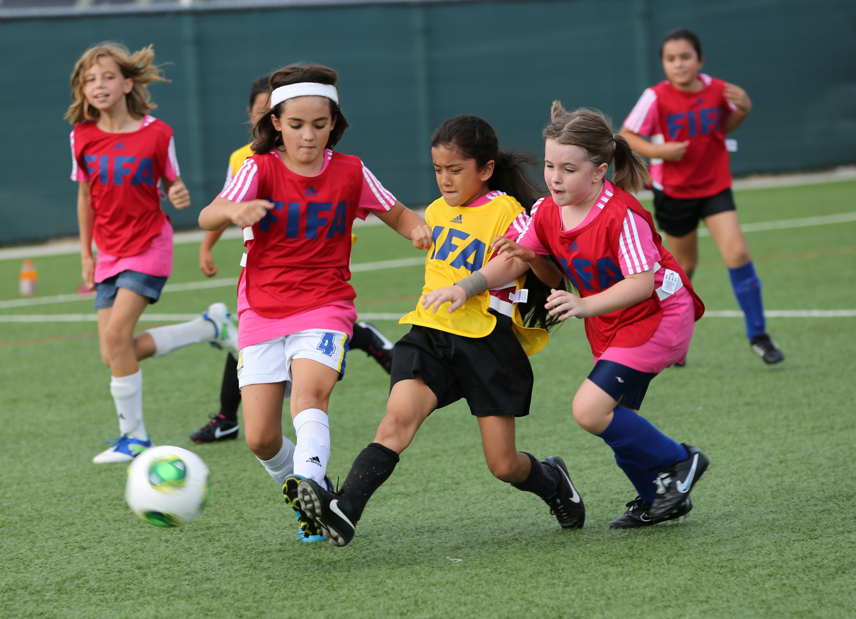

They play soccer at 5:00.
Do you play soccer with your friends?

Slide 7


She does her homework at 3:30.
What time do you do your homework?

Slide 8
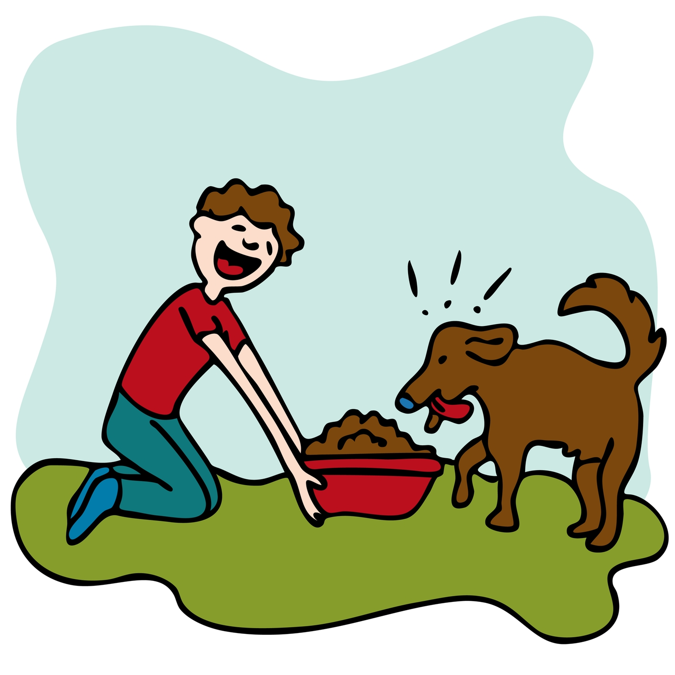
What does he do?
What time does he feed his dog?

Slide 9
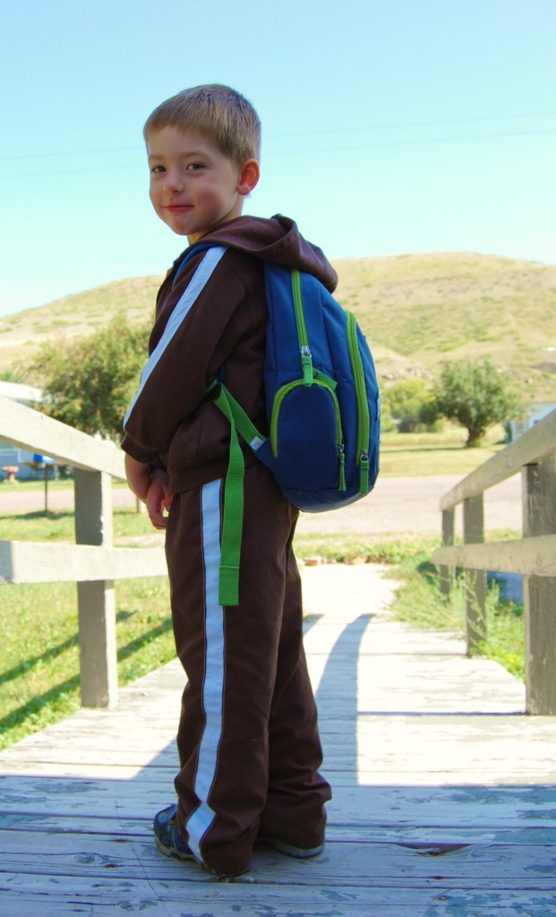
What does he do?
What time does he go to school?

Slide 10
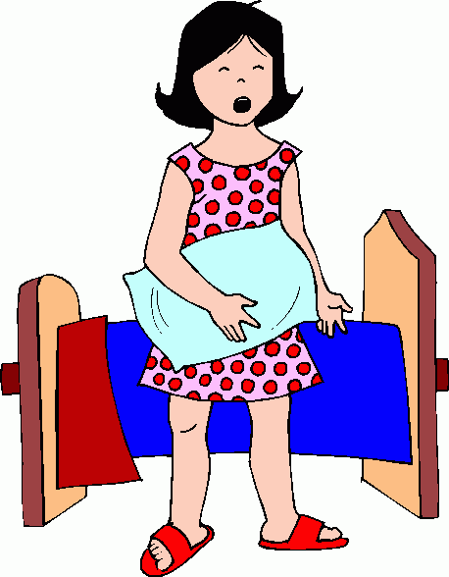
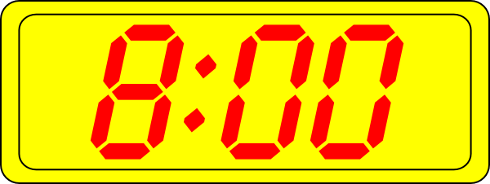
What does she do?
What time does she get up in the morning?

Slide 11
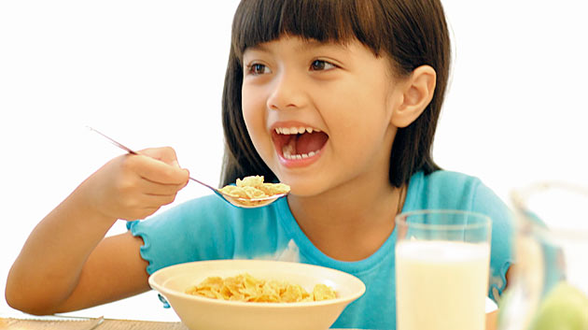
What does she do?
What time does she eat breakfast?

Slide 12
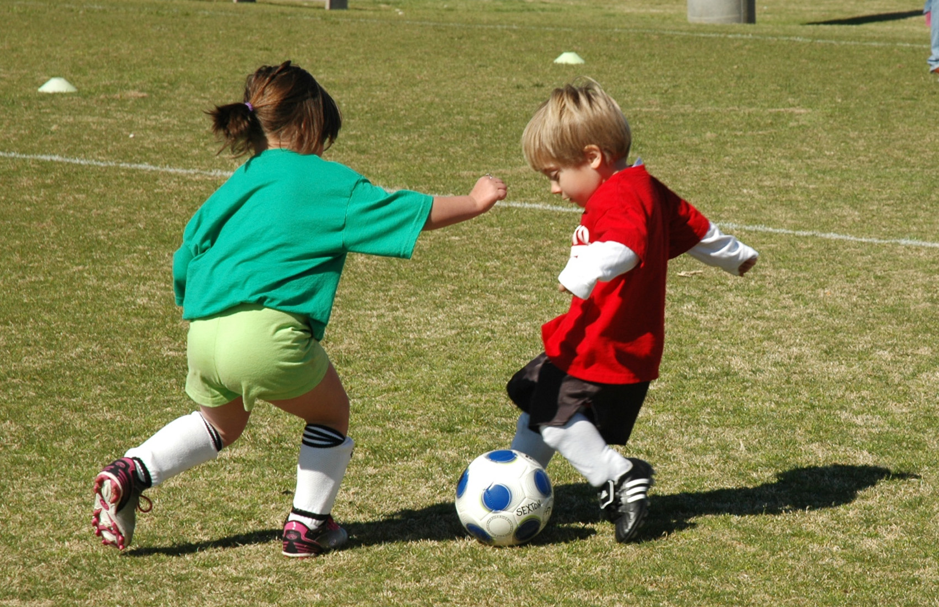
What do they do?
What time do they play soccer?

