Slide 2
COUNTRIES NATIONALITIES LANGUAGES

Slide 4
Tu
Turkey
Turkish

Slide 5
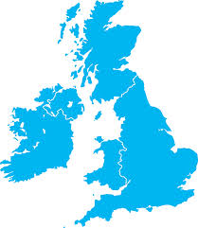
The UK- Britain
British
(English)

Slide 6
The USA
American

Slide 7
Canada
Canadian

Slide 8
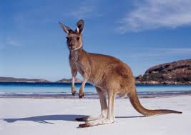
Australia
Australian

Slide 9
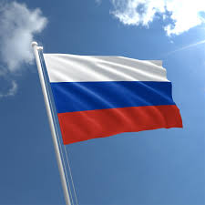
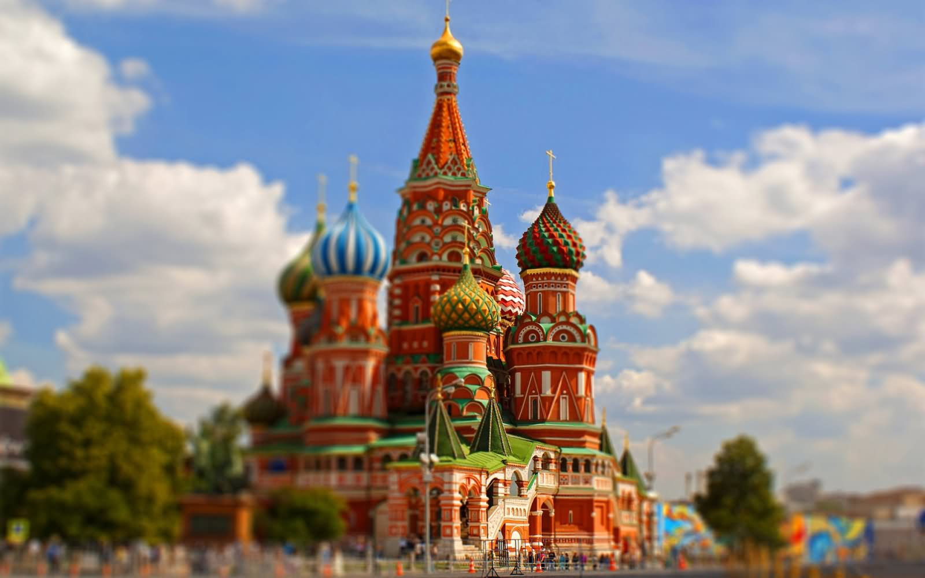
Russia
Russian

Slide 10
France
French

Slide 11
Japan
Japanese

Slide 12
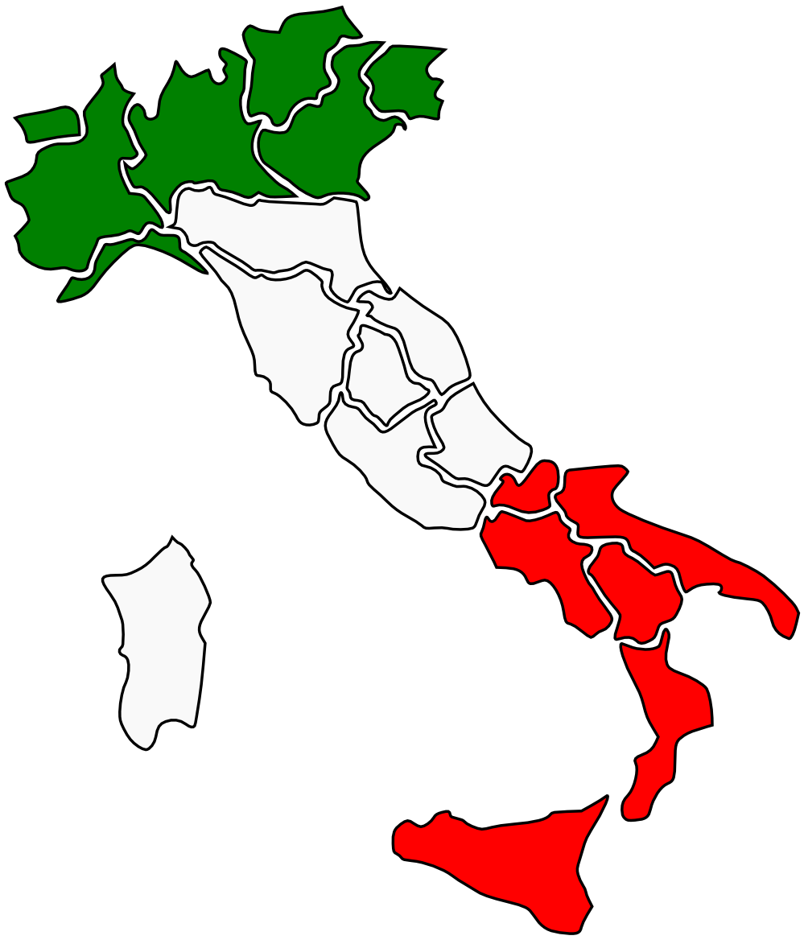
Italy
Italian

Slide 13
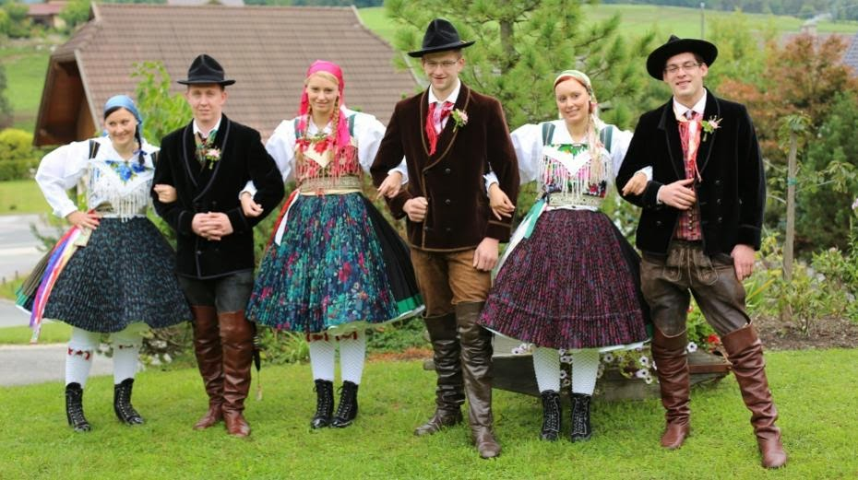
Germany
German

Slide 14
China
Chinese

Slide 15
Where are you from?
I’m from Turkey.

Slide 16
What nationality is she?
She is Chinese

Slide 17
Where is he from?
He is from Russia

Slide 18
Where is he from? What nationality is he?
He is from the USA
He is American

Slide 19
What nationality is he?
He is French

Slide 20
by www.okanelt.com

